Slide 1
Consumer Goods Ad_Hoc Insights

Slide 2
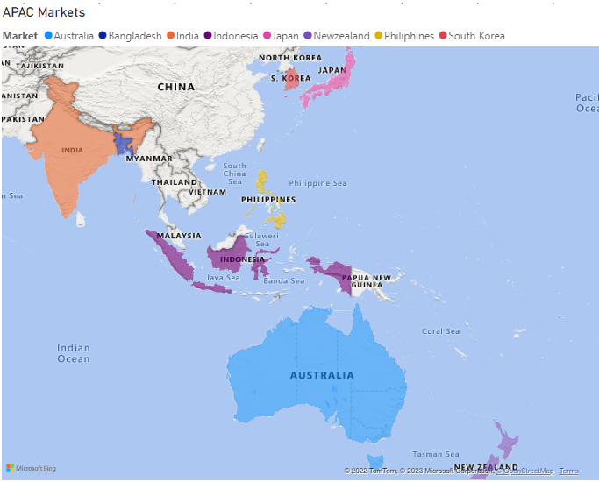
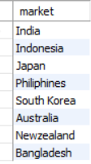
List of Markets
1. Request:
Provide the list of markets in which customer "Atliq Exclusive" operates its business in the APAC region.
Query:
select distinct(market)
from gdb023.dim_customer where
customer = 'Atliq Exclusive' and region = 'APAC’;
Output:

Slide 3
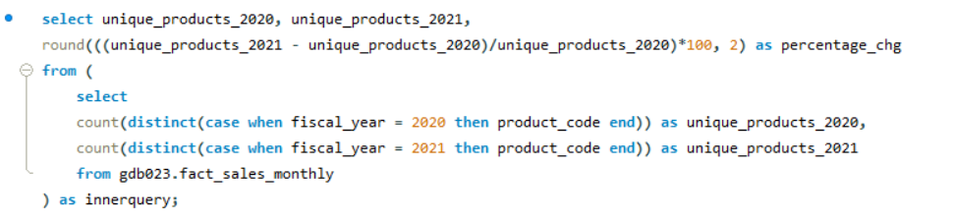

Percentage Unique Product Increase
2. Request:
What is the percentage of unique product increase in 2021 vs. 2020?
Query:
Output:

Slide 4
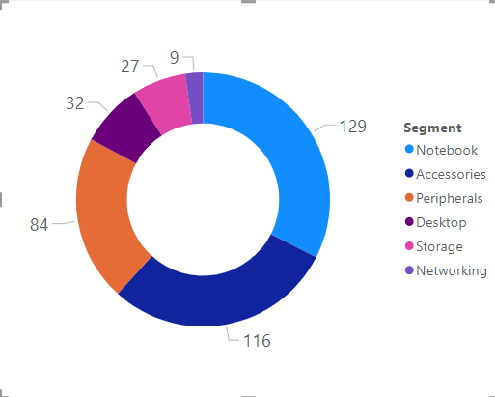
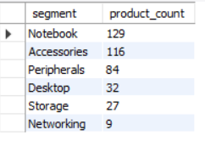
List of Unique Products based on Segment
3. Request:
Provide a report with all the unique product counts for each segment and sort them in descending order of product counts.
Query:
select segment, count(product_code) as product_count
from gdb023.dim_product
group by segment order by product_count desc;
Output:

Slide 5
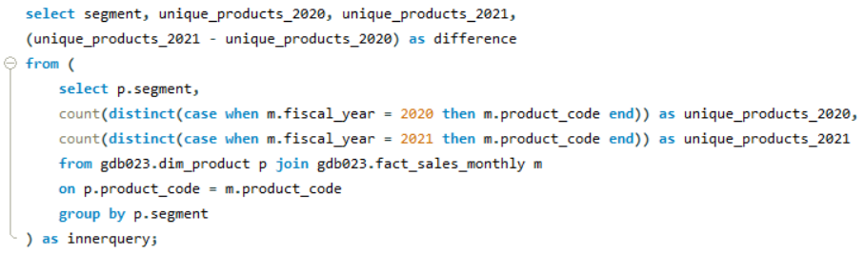
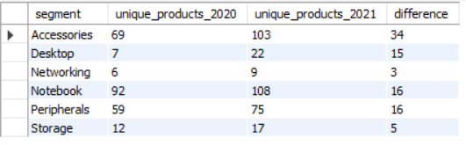
Comparison of Sales in 2020, 2021 wrt. Segment
4. Request:
Follow-up: Which segment had the most increase in unique products in 2021 vs 2020?
Query:
Output:

Slide 6




Products with Highest and Lowest Costs
5. Request:
Get the products that have the highest and lowest manufacturing costs.
Query:
Output:

Slide 7
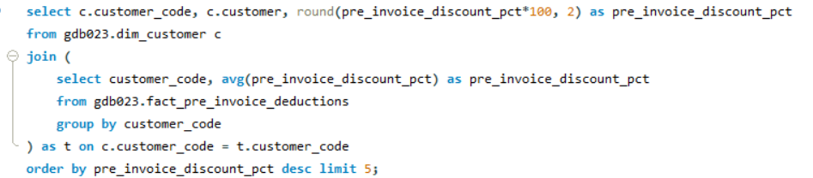
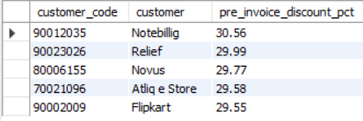
Top 5 Customers with High Pre Invoice Discount
6. Request:
Generate a report which contains the top 5 customers who received an average high pre_invoice_discount_pct for the fiscal year 2021 and in the Indian market
Query:
Output:

Slide 8
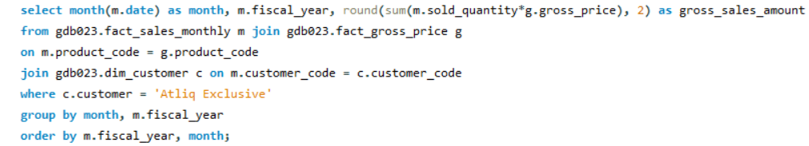
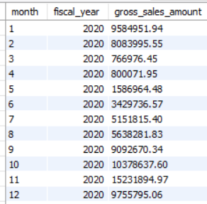
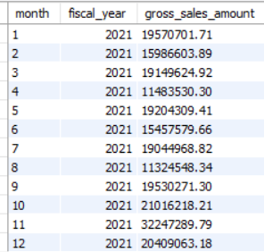
Gross Sales for Atliq Exclusive for each month
7. Request:
Get the complete report of the Gross sales amount for the customer “Atliq Exclusive” for each month . This analysis helps to get an idea of low and high-performing months and take strategic decisions.
Query:
Output:

Slide 9
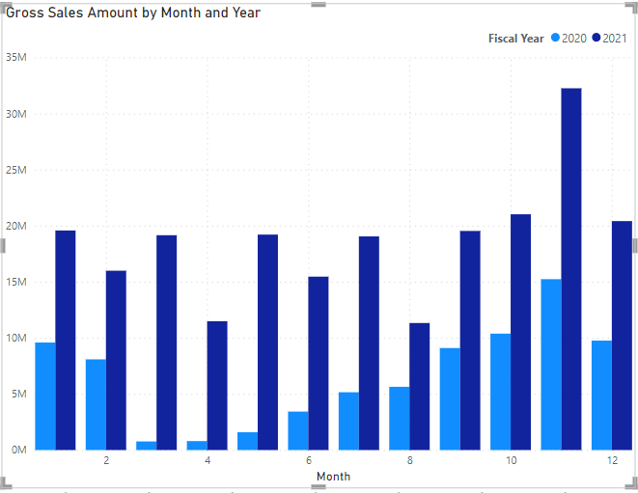
Gross Sales for Atliq Exclusive for each month
Output:

Slide 10

2020 Quarter with Maximum Total Sold Quantity
8. Request:
In which quarter of 2020, got the maximum total_sold_quantity?
Query:
select quarter(date) as quarter, fiscal_year, sum(sold_quantity) as total_sold_quantity
from gdb023.fact_sales_monthly
where fiscal_year = 2020
group by quarter, fiscal_year
order by total_sold_quantity desc limit 1;
Output:

Slide 11
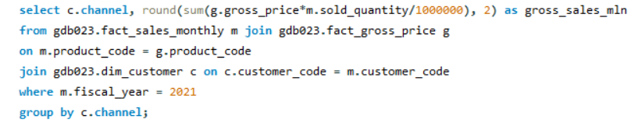
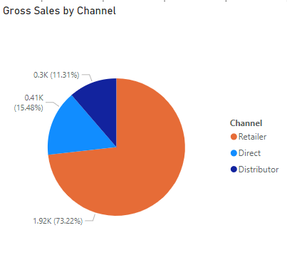

Which Channel brings More Gross Sales
9. Request:
Which channel helped to bring more gross sales in the fiscal year 2021 and the percentage of contribution?
Query:
Output:

Slide 12
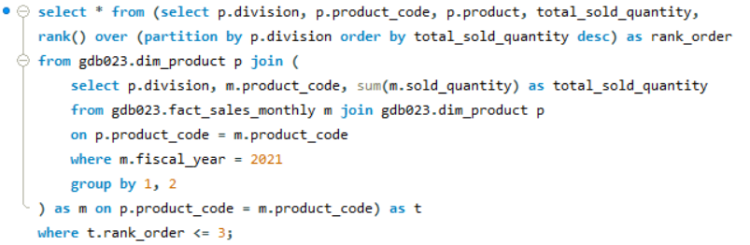
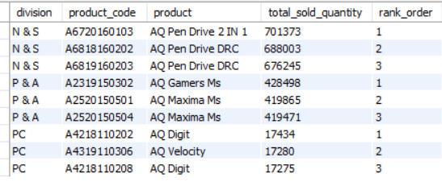
Top 3 Products in each Division with High Sold Quantity
10. Request:
Get the Top 3 products in each division that have a high total_sold_quantity in the fiscal_year 2021?
Query:
Output:

